Slide 1
Operators Caveat
print("Hi"*4)
Works. Why?

Slide 2
Functions

Slide 3
The C++ Way:
double ConvertFahrenheitToCelsius (double fahrenheit)
{
// Conversion function
return (fahrenheit - 32) * (5. / 9.);
}
int main()
{
double fahrenheit;
std::cout << "Insert degrees fahrenheit: ";
std::cin >> fahrenheit;
std::cout << fahrenheit << " in celsius is " << ConvertFahrenheitToCelsius(fahrenheit);
}
The Python Way:

Slide 4
The Python Way
def ConvertFahrenheitToCelsius(fahrenheit):
return (fahrenheit - 32) * (5 / 9)
fahrenheit = float(input("Insert degrees fahrenheit: "))
print(fahrenheit, "in celsius is", convertFahrenheitToCelsius(fahrenheit))

Slide 5
The Python Way
fahrenheit = float(input("Insert degrees fahrenheit: "))
print(fahrenheit, "in celsius is", ConvertFahrenheitToCelsius(fahrenheit), ".")
def ConvertFahrenheitToCelsius(fahrenheit):
return (fahrenheit - 32) * (5 / 9)
Doesn’t work, even though the book says it should. Good rule of thumb is to make sure you define the function before you use it.

Slide 6
Scope

Slide 7
C++
// Global Scope
int X = 99;
void funct(int Y){
// Local scope
Z = X + Y;
}
int main()
{
funct(1);
// result = 100
}
The Python Way:

Slide 8
Python
# Global scope
X = 99
def func(Y):
# Local scope
Z = X + Y
return Z
func(1)
# result = 100
The Python Way:

Slide 9
Modules

Slide 10
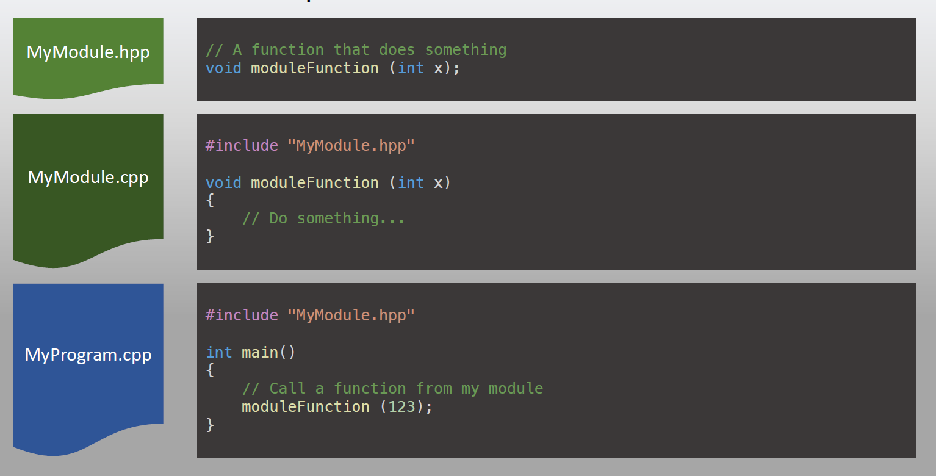
C++

Slide 11
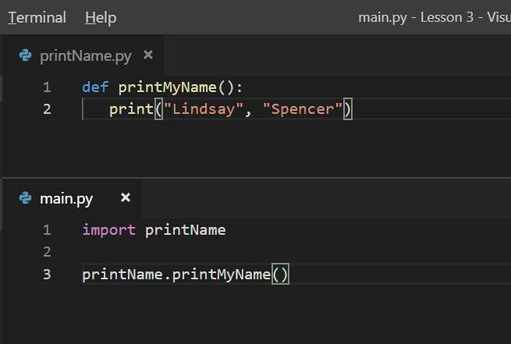
Python

Slide 12
Flow Control & Loops

Slide 13
While Loop
C++
Python
int main()
{
int i = 1;
while (i < 6) {
std::cout << i;
i++;
}
}
i = 1
while i < 6:
print(i)
i += 1

Slide 14
The continue Statement
i = 0
while i < 6:
i += 1
if i == 3:
continue
print(i)
With the continue statement we can stop the current iteration, and continue with the next

Slide 15
The break Statement
i = 1
while i < 6:
print(i)
if i == 3:
break
i += 1
With the break statement we can stop the loop even if the while condition is true.
*https://www.w3schools.com/python/python_while_loops.asp

Slide 16
For Loop
We’ll get to it later . . .

